Slide 1
Calculate the entropy of a subregion using Python computation
110022506 郭弈翔
Key words: BH Thermodynamics, GR, Linear Algebra, QM, QFT

Slide 2
Outline
0I
03
Motivation and Expected Results
Difficulties and Possible Solution
02
04
Results by Doing Python Calculation
Conclusions
Future work

Slide 3
Motivation and Expected Results
Black Hole Thermodynamics
Analytical Solutions (Original vs. Advanced)
Expected Results

Slide 4

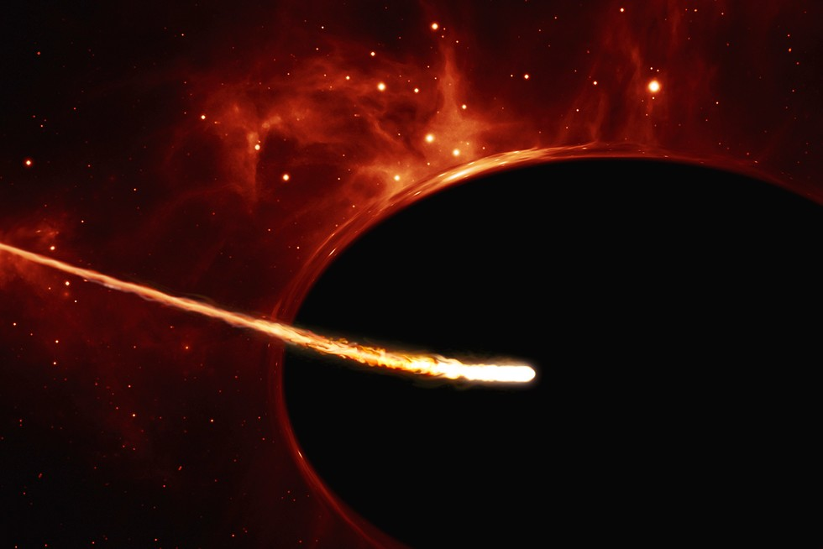
Motivation
Consider black holes as thermodynamics objects… in 1974, Jacob Bekenstein and Stephen Hawking using the BH thermodynamics to confirm that the entropy of BH:
Goal: prove the general case
A: Surface area of BH
Credit: Colin Stuart

Slide 5


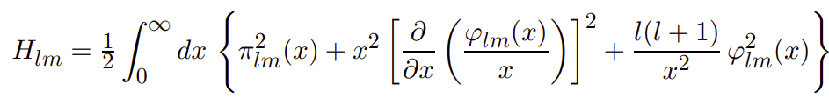

Original Analytical Solution
The Hamiltonian for a massless scalar field* in the continuum flat space: by changing the coordinate into spherical coordinate: where
*Massless scalar field: The easiest and clean field*
$l$: Angular mode number
Ref. Srednicki, Mark. "Entropy and area." Physical Review Letters 71.5 (1993): 666.

Slide 6
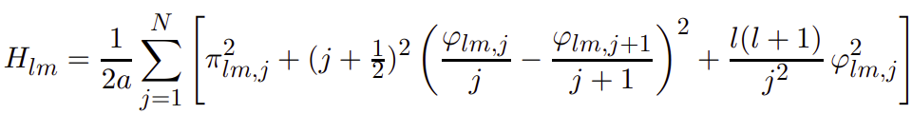
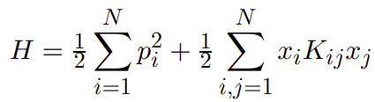
Original Analytical Solution
After discretization, we find that the Hamiltonian of massless scalar field has something in common with the N-coupled Oscillators.
N-coupled Harmonic Oscillator
K : coupling matrix

Slide 7
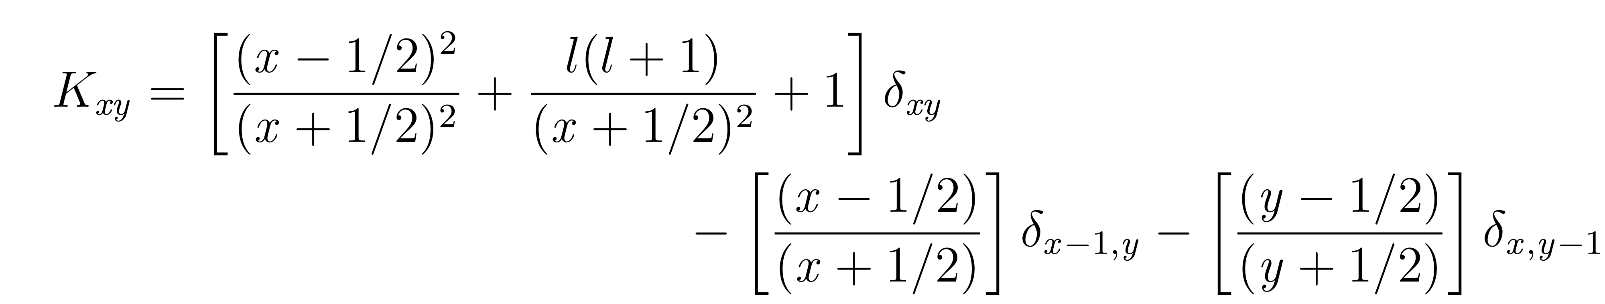


Original Analytical Solution
By comparison, we find the coupling matrix $K_{xy}$ Solving the eigenvalue of $K_{xy}$, we can get the entanglement entropy of the subregion!

Slide 8
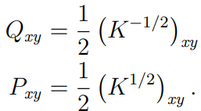

Advanced Analytical Solution
Re-express the canonical variable $φ、π$ by the correlation function $Q=\text{⟨}φ_{i}φ_{j}\text{⟩}、P=\text{⟨}π_{i}π_{j}\text{⟩}$ after several calculations, we will find that Q and P are the submatrix related to $K_{xy}$:
Reduce matrix size, reduce the computing time!

Slide 9
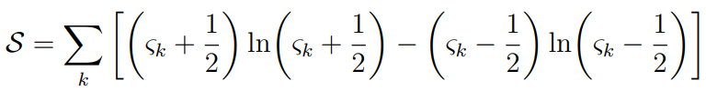


Advanced Analytical Solution
Put the result back to the entanglement entropy formula, we can get the (angular) mode entropy
After summing all angular mode, the total entropy is as follow:
$ς_{k}$: Eigenvalue of ${(QP)}^{1/2}$

Slide 10

Expected Results
The first solution calculated^{*1} $S(R)\sim 0.30 R^{2}$
Later, the more accurate solution is given^{*2}
$$S(R) \sim 0.295406 R^{2}$$
*1 Srednicki, Mark. "Entropy and area." Physical Review Letters 71.5 (1993): 666. *2 Lohmayer, R., et al. "Numerical determination of entanglement entropy for a sphere." Physics Letters B 685.2-3 (2010): 222-227.

Slide 11
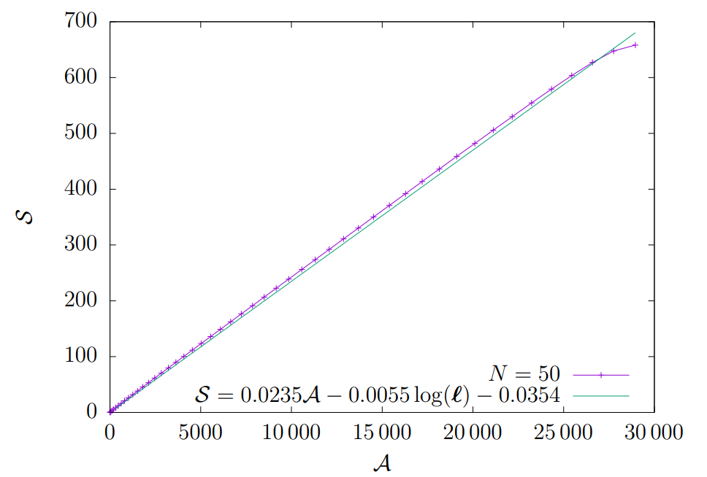

Expected Results
To push it further, we fit the data points to the functional form
$$S\left(R\right)=a∗𝒜+b∗\log\left(R^{2}\right)+c$$
and the coefficients are:
$a=0.0235, b=−0.0055, c=−0.0354$

Slide 12
Results by using Python Computation

Slide 13
Results
There are 3 variables to be determined: N: the matrix size / the system size L: the number of angular mode to be sum up R: the radius of the subregion

Slide 14
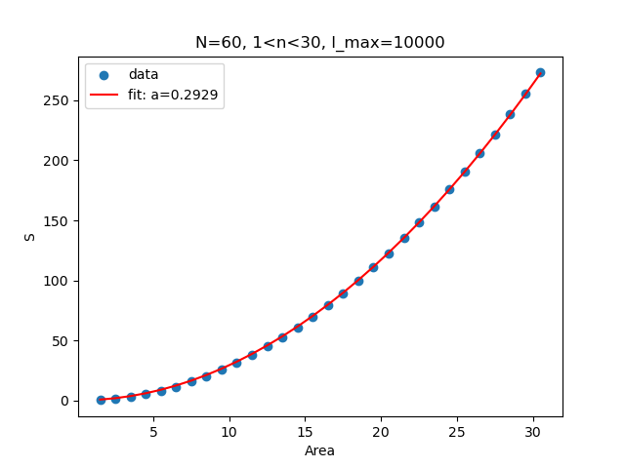
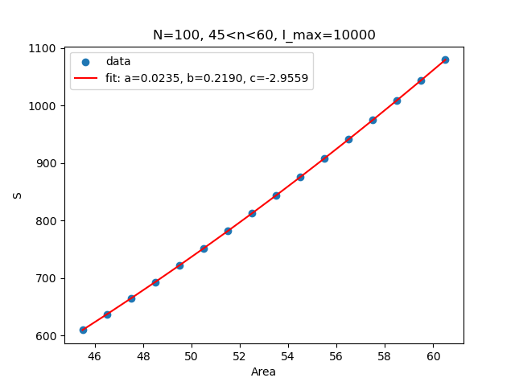

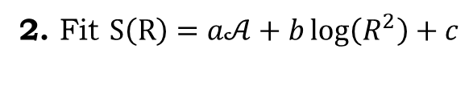
Results
1. Fit $S\left(R\right)=aR^{2}$
2. Fit $S\left(R\right)=a𝒜+b\log\left(R^{2}\right)+c$
R
R

Slide 15

Results
(1.) Fit $S\left(R\right)=aR^{2}$
 | N | L | R | a
Expected 1 | 60 | ? | 1~30 | ~0.30
Expected 2 | 5000 | ? | 45~60 | 0.295406
My result | 20 | 1000 | 1~10 | 0.2802
 | 20 | 3000 | 1~10 | 0.2803
 | 40 | 3000 | 1~20 | 0.2904
 | 60 | 3000 | 1~30 | 0.2928
 | 60 | 10000 | 1~30 | 0.2929
 | 100 | 10000 | 1~50 | 0.2943
 | 500 | 10000 | 45~60 | 0.2948

Slide 16
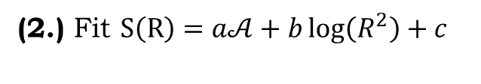
Results
(2.) Fit $S\left(R\right)=a𝒜+b\log\left(R^{2}\right)+c$
 | N | L | R | a | b | c
Expected 2 | 5000 | ? | 45~60 | 0.0235 | -0.0055 | -0.0354
My results | 20 | 1000 | 1~10 | 0.0235 | -0.1743 | -0.3307
 | 20 | 3000 | 1~10 | 0.0235 | -0.1764 | -0.3282
 | 40 | 3000 | 1~20 | 0.0235 | -0.1759 | -0.3341
 | 40 | 5000 | 1~20 | 0.0235 | -0.1763 | -0.3333
 | 100 | 10000 | 45~60 | 0.0235 | 0.2190 | -2.9559
 | 1000 | 10000 | 45~60 | 0.0235 | -0.1735 | -0.3560

Slide 17
Difficulties and Possible Solution

Slide 18

Difficulties
1. Construct matrix $A^{n}$ from given $A$
if we have a simple 3x3 matrix: $A=\left(\begin{matrix}1 & 2 & 3 \\ 4 & 5 & 6 \\ 7 & 8 & 9\end{matrix}\right)$
for n=2, it seems that super easy to calculate…
but what if n=10? Do you calculate it by A*A*A*A… ?
n=1/2? n=-1/2? n=1/10?

Slide 19

Difficulties
1. Construct matrix $A^{n}$ from given $A$
Solution: Let λ = eigenvalue of A, $v$ = eigenvector of A, then
$A^{n}=v∗\left({\text{λ}}^{n}∗I\right)∗v^{T}$

Slide 20

Difficulties
2. The possible reason contributes to the bad sub-leading coefficients
● The value of N, L is not big enough?
● Initial value of coupling matrix $K_{xy}$ might be wrong? ● Unknown code bug?

Slide 21
Conclusions

Slide 22

Conclusions
1. The $S\left(R\right)=aR^{2}$ fit is somehow succeeded, but still need to be improved with large N and large L value.
2. The $S\left(R\right)=a𝒜+b\log\left(R^{2}\right)+c$ fit is perfect for the leading term, but disastrous for the sub-leading term.

Slide 23
Future work
1. Trying to use parallel computing to get access to the higher N, L number
2. Challenge the more difficult case like:
● the more difficult system (e.q. Massive Klein-Gordan Field)
● the more difficult properties (e.q. Pseudo Entropy)

Slide 24

Q&A
Thanks for listening

